Slide 1
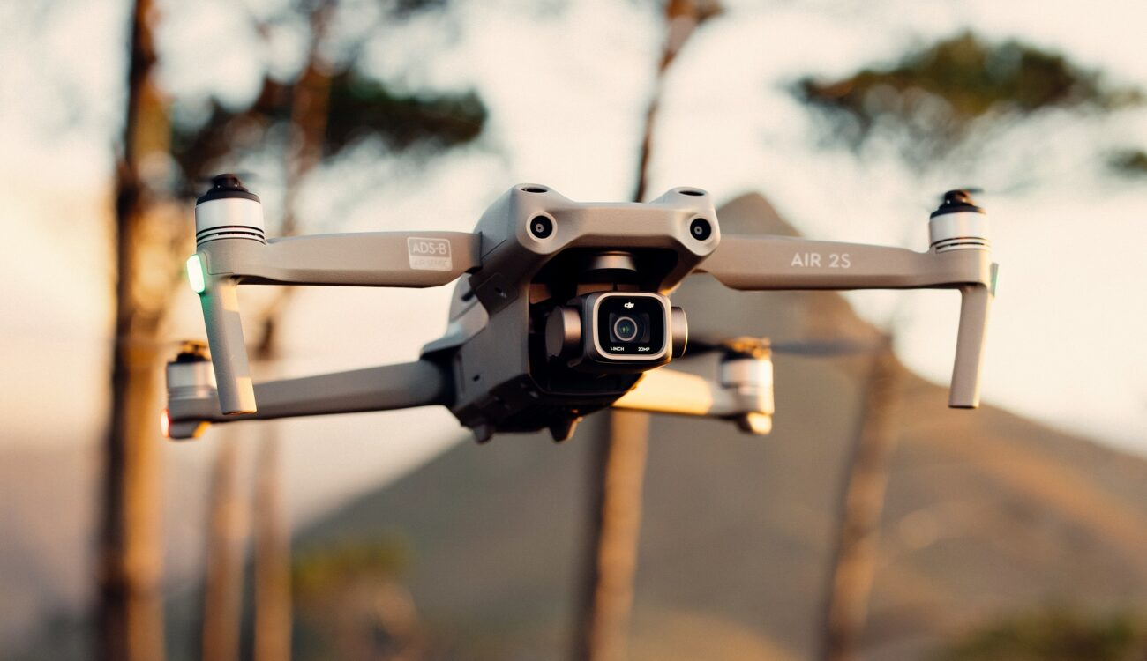
SENTINEL DRONE
BY: KIRTI AND ANAM NAAZ
Caption

Slide 2

STORYLINE
The galvanisation of complex engineering breakthroughs has caused a new rise in Grand Theft Auto related cyber crimes.
In eYRC 2022, we are considering a similar scenario to tackle.
With the technological improvements in the drone industries, and amalgamation of drones with various GIS (Geo-spacial Information systems) techniques, we can help prevent grand thief auto using Sentinel Drones.
The drones will be used to canvas an area of land while simultaneously scanning it for the “fingerprint” (to simplify, we’ll be using a rectangular red box) of a stolen car.
Now mind you that the drone knows its coordinates globally, using GPS in the real world and a ceiling mounted camera in our simulated world.
Through GIS the drone will use pattern matching on the land to detect the location of the car, estimate the coordinates and send the data back to the main server.
Caption

Slide 3
Applications
It can be used to prevent Grand Theft Auto.
In hyper local cases it can be used in warehouses for item detection.
For outdoor use it can be used in military applications like bomb detection, or for simply canvassing a particular area and numerous other places.
Our aim is to develop robots centred on reducing human labor and improving the quality of life of humans.

Slide 4
What have we learnt so far?
The basics of Python and ROS libraries for Python.
To build a PID (proportional integral derivative) control system to stabilise the quadcopter at any given position in a simulation environment in Gazebo
About drone motion.
To detect object from the given image and find its pixel co-ordinates using open CV.
To scan the entire city area(arena) using drone, detect object from the drone camera by using ROS and Open CV.

Slide 5


